Slide 1
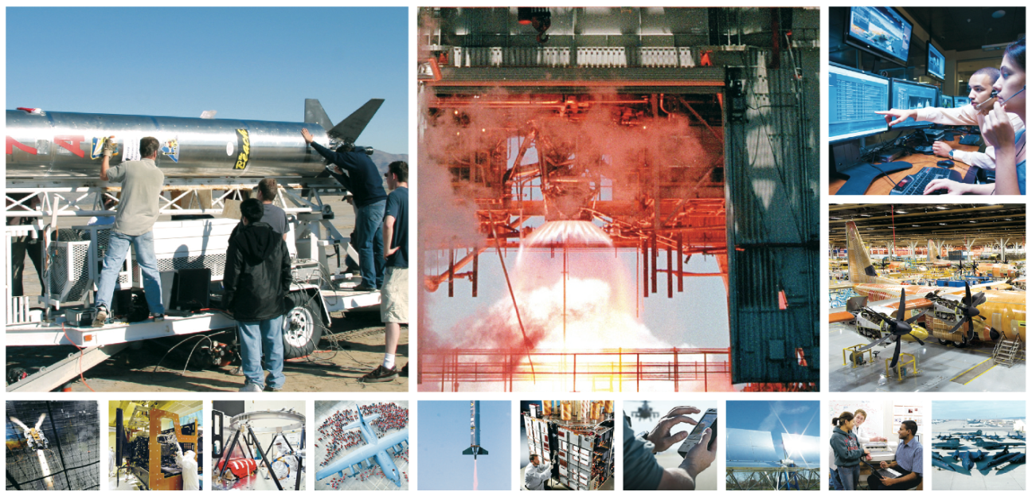
CULTIVATING ENGINEERING TALENT IN THE ANTELOPE VALLEY

Slide 2
Program Uniqueness
Degree Completion for BS Electrical Engineering and BS Mechanical Engineering
Cohort Based
Opportunity to engage in extensive engineering projects over the course of the program
Encourages strong teamwork
Able to emphasize leadership, enhance communication skills, & develop professionalism
Small Program
Goal is to enroll 25 students in each discipline in the fall (50 students total)
Providing unprecedented access to industry
Program is very personal
Graduation in 2.5 years guaranteed (Students must pass classes and stay in good standing

Slide 3
Program Uniqueness
Program is highly structured
Curriculum tailored for our region
Experienced and highly capable academic and industry faculty
Very ‘hands-on’ student experiences
Student Preparation
Occurs at community college or at another university
Experience indicates students enter program extremely well prepared

Slide 4
Schedule
Sunday | Monday | Tuesday | Wednesday | Thursday | Friday | Saturday
 | 9AM |  | 9AM |  | 9AM
 | 6PM+ |  | 6PM+ |  | 6PM+
Affords opportunity for students to engage with industry as interns during academic year as well as during summers

Slide 5
Accreditation
Western Association of Schools and Colleges (WASC)
Accreditation Board for Engineering and Technology (ABET)
Both BS Mechanical and Electrical
Engineering programs accreditation received in
August
Identified as BS Mechanical Engineering
Extension Program and BS Electrical
Engineering Extension Program on the
ABET website

Slide 6
Student Success
Due in very large part to outstanding support from our community, education, and industry partners
Graduated two classes
14 EE, 18 ME, 32 total
One Magna Cum Laude, three Cum Laude
Cohort 3 to graduate in December
4 EE, 10 ME, bring total graduates to 46
One Magna Cum Laude, one Cum Laude
Cohorts 4 & 5 will add 25 ME & 13 EE Graduates

Slide 7
Student Success (Performance)
Graduates enjoy 100% employment rate
97% graduation rate
97% retention rate for program
Graduates compete well nationally
We have one NSF Graduate Research Fellowship awarded
Our graduate is conducting research at Stanford University
The Fellowship will carry graduate through Ph.D.
Students receive summer internships through Pathways program
NASA Marshall Space Flight Center - Huntsville, AL
US Navy Ordnance Disposal Technology Division – Maryland
NAWCWD (China Lake)

Slide 8
Student Success (Internships)
Internships are paid
Regional Internships
Northrop Grumman
AFRL
NASA Armstrong Flight Research Center
NAWCWD (China Lake)
Lockheed Martin (Flight Test)
AF Test Wing
BAE Systems
The Spaceship Company
Jacobs Engineering
Crissair
Pacific Seismic Products
INCU, LLC
TYBRIN

Slide 9
Student Success (Performance)
Students and graduates highly regarded by regional industry
Approximately 80% of students have internships at any given time
Many interns promoted to employee status while students
Graduates performing well in industry
Three graduates at one company reported to have received perfect performance reviews
One of the three known to have been promoted and named lead engineer for the department less than two years after graduation
Average starting salary for graduates approximately $70,000/year

Slide 10
In Conclusion
Outstanding unique program design delivered by CSULB College of Engineering
Only one issue to overcome
Enrollments have not exceeded 60% of that required for self sustaining
Revenue short fall for existing student base may reach $250,000 by December 2017
Solutions being pursued to mitigate revenue shortfall
Marketing expanded beyond Southern California to attract more students

Slide 11
QUESTIONS?
Degree Completion Program in
Mechanical & Electrical Engineering
Offered in the Antelope Valley
http://www.ccpe.csulb.edu/engineering
Notes:
11

